Slide 1
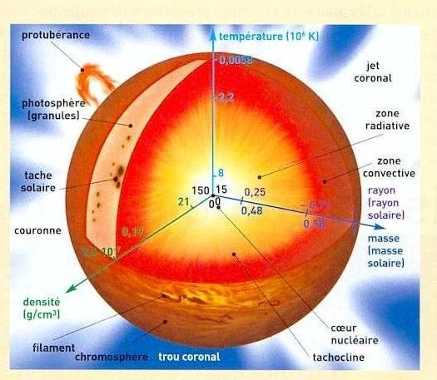
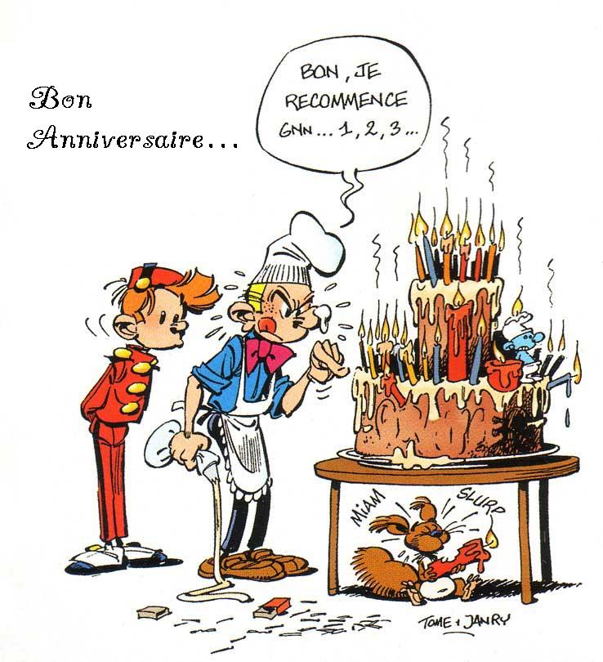
Happy birthday Alan our common interest for fundamental physics Our GOLF common contribution

Slide 2
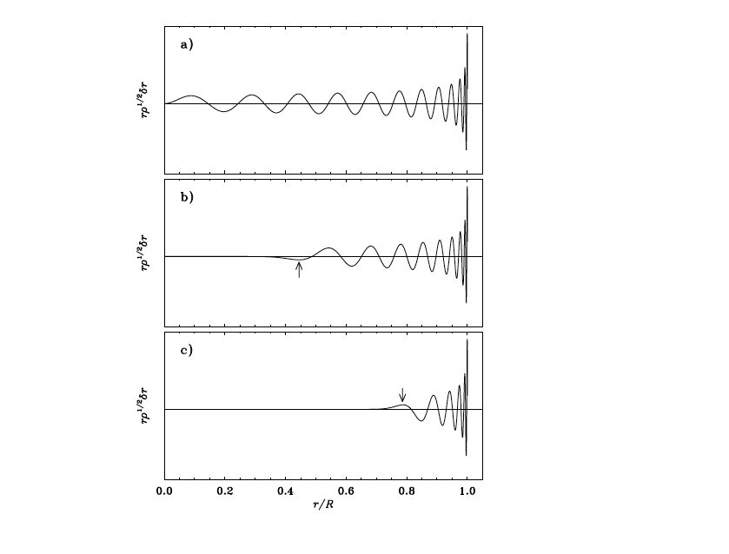
Low degree modes The core: 0.5 microHz 11 year variability: about 0.5 microHz

Slide 3
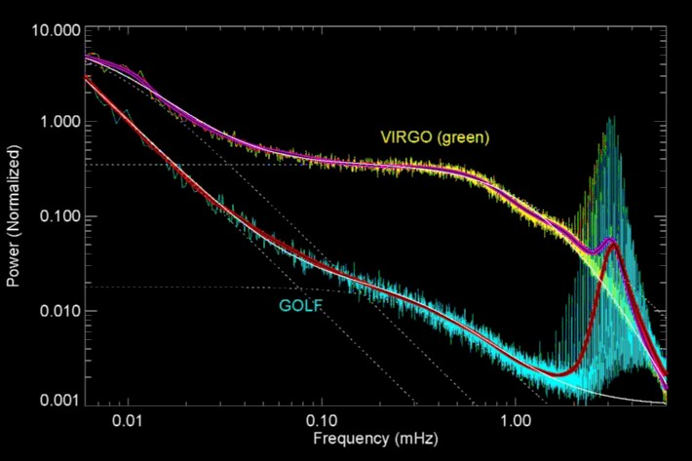
Global oscillations at low frequency We use oscillations below 1.6 mHz: check of the SSM hypotheses, predictions of neutrinos
Turck-Chièze et al. 2001
Turck-Chièze et al. 2011
Turck-Chièze & Couvidat Report in Progress in Physics 2012

Slide 4
Global oscillations at low frequency Shallow dynamo or global dynamo: 2 and 11 year cycles Salabert et al. 2009, Simoniello et al. 2013

Slide 5
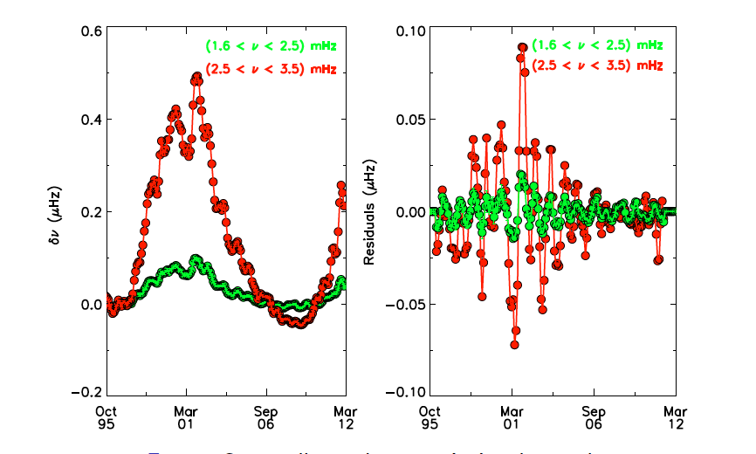
GONG data

Slide 6
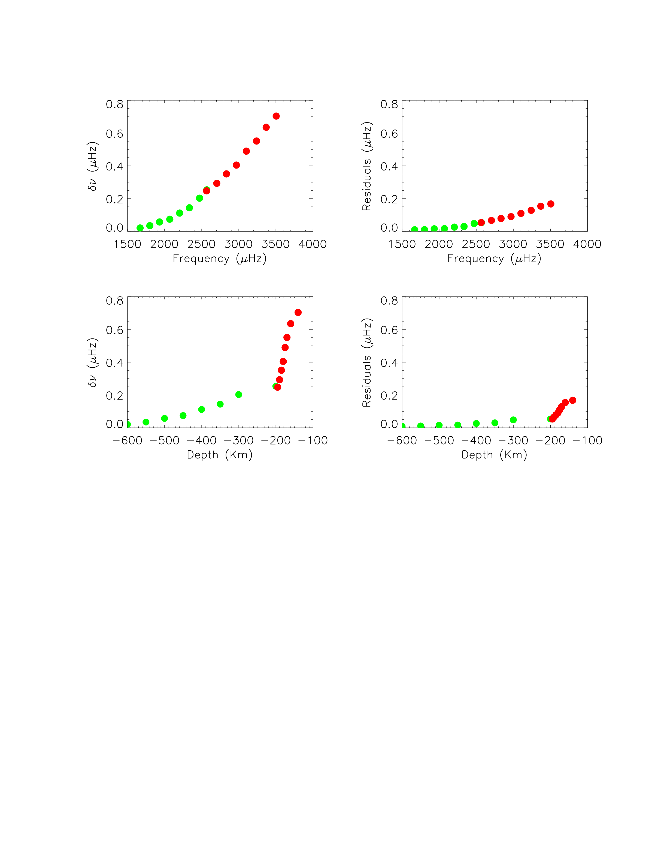
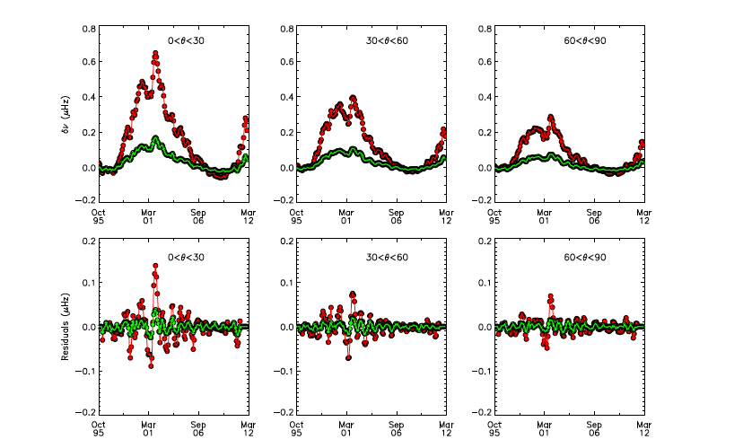
Common Subsurface direct magnetic effect Simoniello, …T-C…ApJ lett 2013
The QBP might be the result of the beating between components of the magnetic field of the sub surface, not a second dynamo

Slide 7
Have we detect gravity modes ? Non anticipated phenomena
Solar Granulation noise
Not measurable before SOHO launch

Slide 8
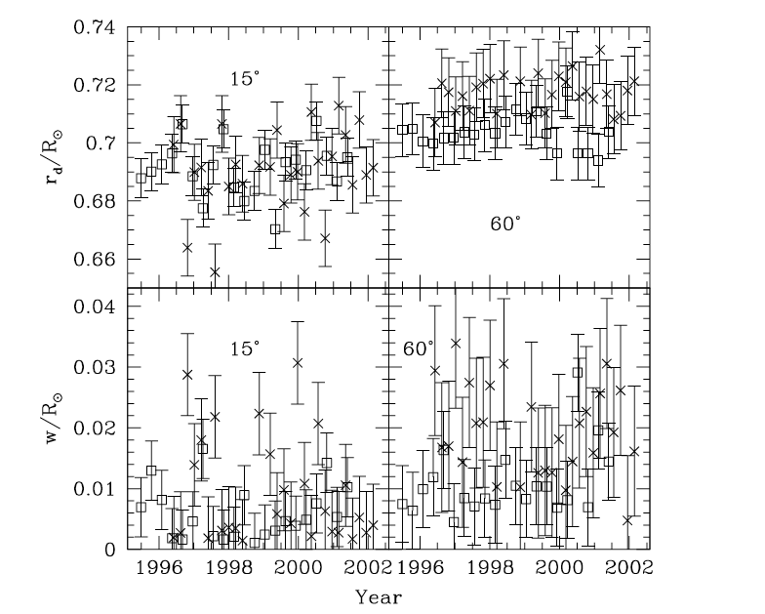
Have we detect gravity modes ? Non anticipated phenomena: Basu & Antia 2003
Impact on the lifetime of the modes and their central frequency

Slide 9
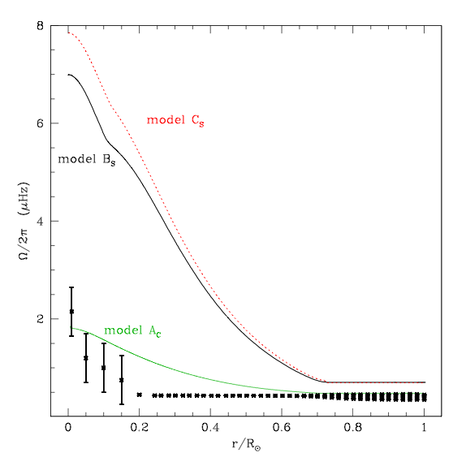
The solar rotation of the core Turck-Chièze et al. 2004,Garcia et al. 2007, 2011, T-C et al. 2010
Yes, we believe for numerous reasons, it would nice to confirm and extend, GOLFNG is built, GOLFNG in space
Model Bs 20 km/s at MS + magnetic braking;
Model Cs 50 km/s
Model Ac is a model where the initial rotation is very slow: 2km/s

Slide 10
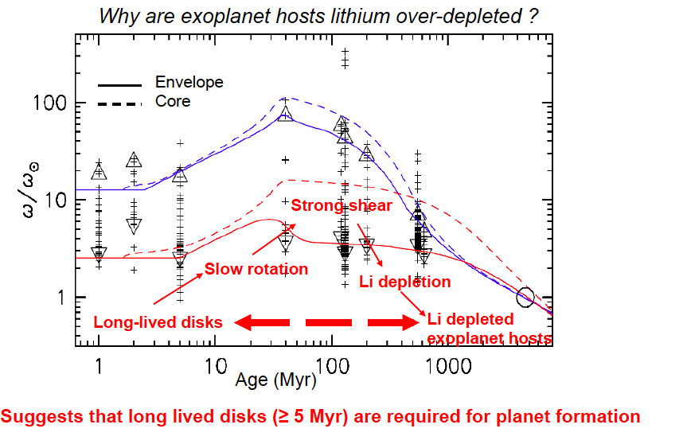
Bouvier et al. 2009, 2013

Slide 11
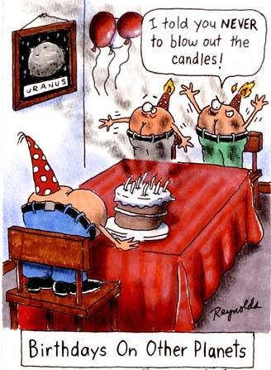
Thank you for this adventure, thank you to Jacques Charra too
Space climate is developing
Exoplanets need to be understood
GOLF is continuing to produce data and we continue to work on
The successor of GOLF has been qualified in our laboratory
Turck-Chièze et al. 2012 RAA: all the values
You should be proud of our space common experience

